Slide 1







Technicals of Stock Market and Trading
Quant Foundations - Day 2
Presenters
Ayush Aware
Archit Mangrulkar
Notes:
Good evening everyone!

Slide 2
Difference between Technical and Fundamental Analysis
Technical
Market action for short term trades
Studies effect of market movement
Use various indicators
Fundamental
Economic factor, Supply and demand for long term investment.
Studies cause of market movement (Always wants to know why)
Use fundamental ratios. Eg ROA, ROE, P/E, EPS, Debt/Eq

Slide 3
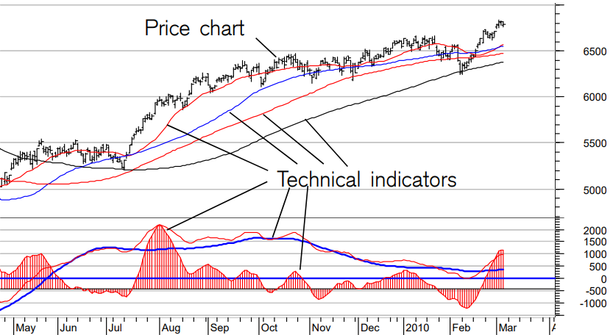

Slide 4
01
Why Technical Analysis?
02
Introduction
03
Candlesticks
04
Volume
05
Support and Resistance
06
Indicators
06
Coding

Slide 5
Why Technical Analysis?
Attempt to forecast stock prices on the basis of market derived data.
Answers the questions when to enter and exit. (Time)
To understand psychology.
Early signals

Slide 6

Assumptions
History repeats itself
Prices moves in trend
Not How but Why
Market discounts everything

Slide 7
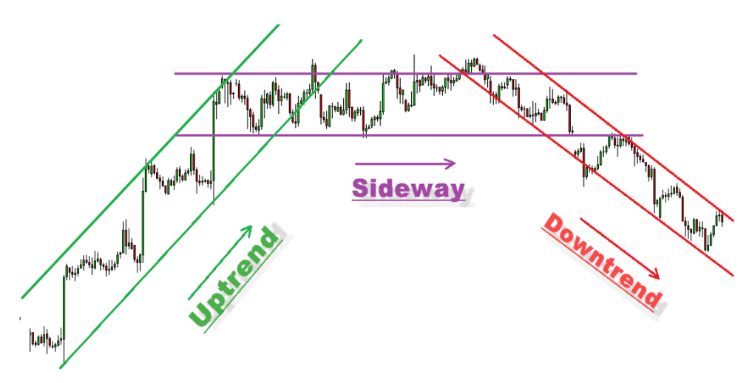
Trends
Upward Consolidated Downward

Slide 8

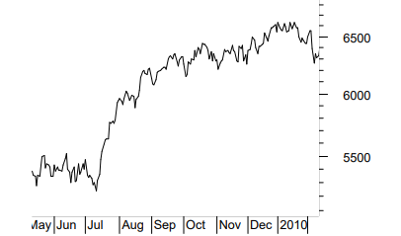
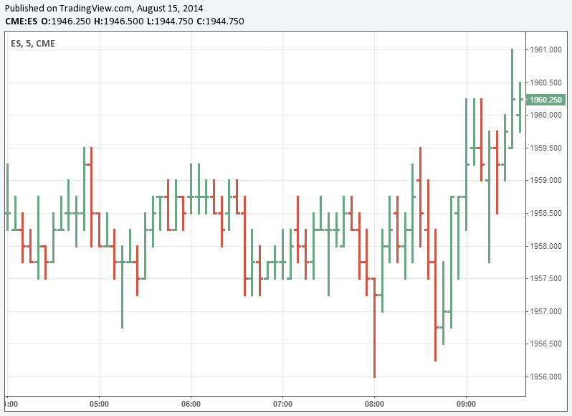
Charts
Line and Bar
Line chart
Bar chart

Slide 9
Single Candlesticks
Marubozu
(open = low, close = high….bullish)
Spinning Top
Small body(indecision)
Confidence
Buyers will only buy and for sellers its reverse
Indecision
Bulls/ Bears are not in control.
Close
Open
Open
Close

Slide 10

Umbrellas
(Colour does not matter here)
Shadow to real body ratio 2:1
Hammer …At the bottom of the downtrend
Hanging Man …At the top end of the uptrend
Close
Open
Prior trend should be downward
Open
Close
Prior trend should be upward

Slide 11
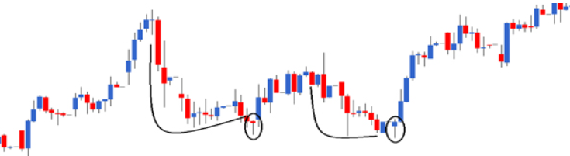
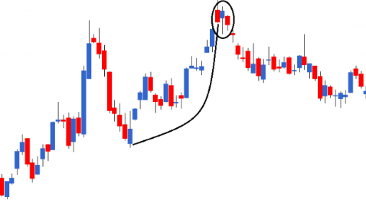

Slide 12

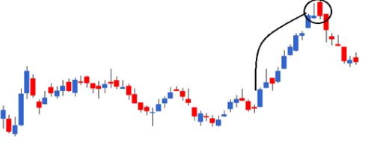
Shooting Star
(Colour does not matter here)
Shadow to real body ratio 2:1
Close
Open
Open
Close

Slide 13
Multiple Candlestick Patterns
Bullish/Bearish Engulfing
Bullish/Bearish Harami
Morning Star, Evening Star

Slide 14
Engulfing
Bullish
Bearish
Green engulfs Red
Downward —>Upward
Red engulfs Green
Upward —>Downward

Slide 15
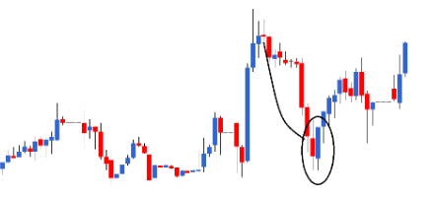
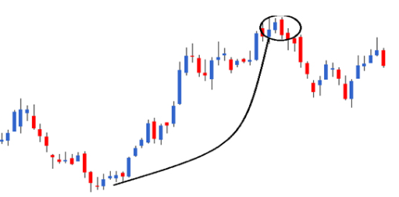

Slide 16
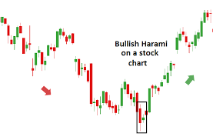
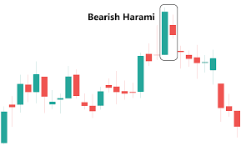
Haramis
Don’ go by its Hindi ‘Harami’
Two candlesticks
1st long 2nd short in length

Slide 17
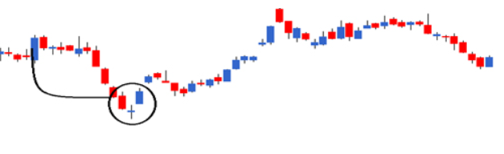
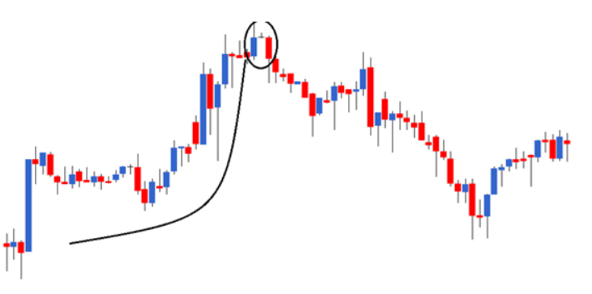
Morning Star and Evening Star
Three candlesticks/trading sessions
Presence of gap

Slide 18
Fibonacci Retracement
0, 1, 1, 2, 3, 5, 8, 13, 21, 34, 55, 144, 233, 377….
21/13 = 1.618
377/233 = 1.618
13/21 = 0.618
233/377 = 0.618
13/34 = 0.382
21/55= 0.382

Slide 19
Relation
61.8%, 38.2%, 23.6% are used retrace back the prior trend
489-380 = 109
61.8% x 109 = 67.36
Retracement at 61% = 489 - 67.36 = 421.6

Slide 20
Support & Resistance
Specific price points which attract maximum buying/selling
A support level occurs where buying becomes strong enough to stop a falling trend
A resistance level occurs where selling becomes strong enough to stop a rising trend

Slide 21
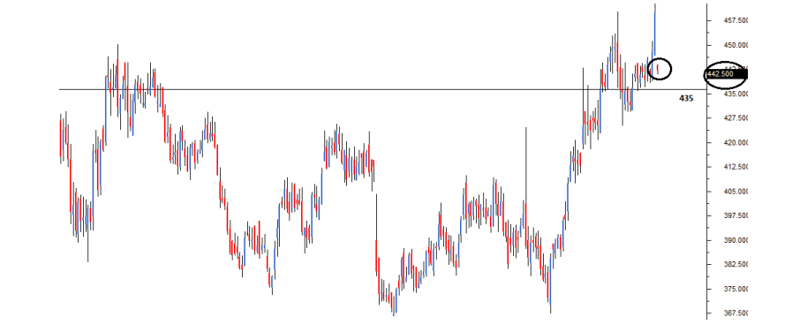
Cipla Ltd. Current Market Price : 442.5 Support Value : 435

Slide 22
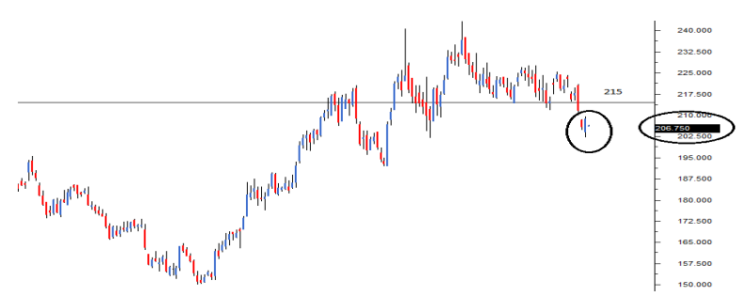
Ambuja Cements Current Market Price : 206.75 Resistance Value : 215

Slide 23
Volumes
Number of shares traded during a time period
Measures pressure behind given price movements
Help identify trends in stock-price movements
Smart Money Concept

Slide 24
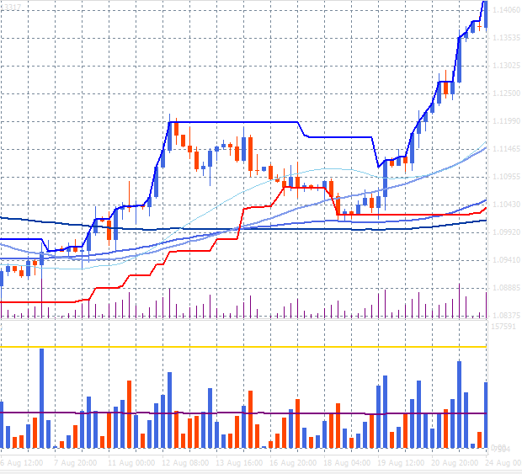
Uptrend

Slide 25
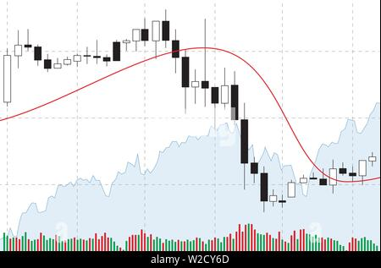
Downtrend

Slide 26
Quantitative Analysis
Using statistical data for anticipating stock trends
Moving Averages
SMA
WMA
EMA
Oscillators
RSI
MACD

Slide 27
Moving Averages
Each point on the n-day moving average is an average of all the close prices for the previous n-days
When a price breaks above (or below) the moving average, it can be interpreted as a sign to buy (or sell)
Simple Moving Average & Weighted Moving Average
SMA_{t} = ( x_{o} + x₁ +..... + x_{n} )
n
WMA_{t} = (a₀ x_{o} + a₁x₁ +..... + a_{n}x_{n} )
n

Slide 28
Exponential Moving Average
EMA_{t} = Value_{t} x ( ) + EMA_{t-1} x {1-( )}
Smoothing factor is a measure of influence of the recent data points (generally 2)
EMA_{t} = Value_{t} x ( ) + EMA_{t-1} x ( )
Smoothing
1 + N
Smoothing
1 + N
2
1 + N
N - 1
1 + N

Slide 29
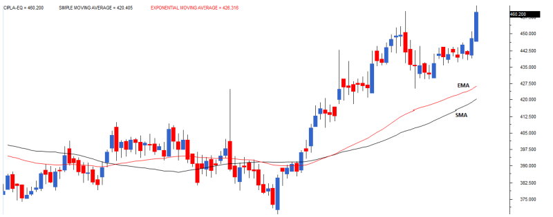
Cipla Ltd. SMA EMA

Slide 30
Identifying Stock Trends
If the current price rises above (or falls below) the MA, look for buying (or selling) opportunities
Gives better margins during trends
Strategy
Enter long position when the current price rises above the MA
End long position when the current price falls below the MA

Slide 31
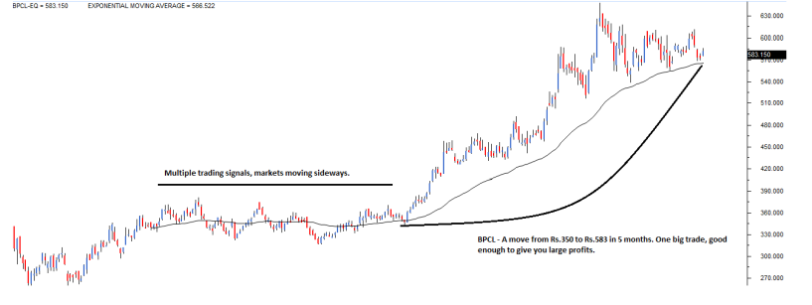
BPCL EMA

Slide 32
Moving Average Crossover
In the plain vanilla moving average system, we saw a lot of signals and the signals during sideways trends were not profitable
Short-term & Long-term moving average
Strategy
Enter long position when the short-term MA rises above the long-term MA
End long position when the short-term MA falls below the long-term MA

Slide 33
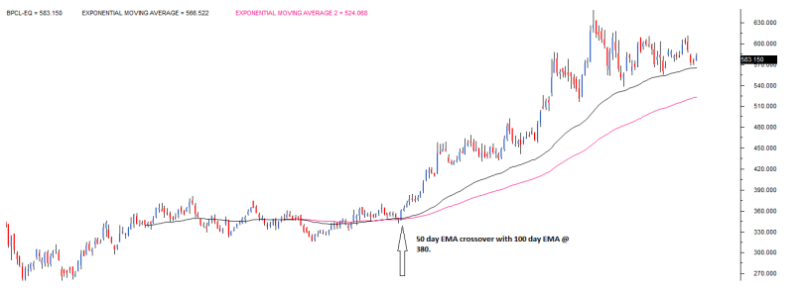
BPCL 50 day EMA 100 day EMA

Slide 34
Indicators
Independent trading systems based on preset logic
Leading & Lagging Indicators
A leading indicator signals the occurrence of a new trend in advance
A lagging indicator signals the occurrence of a new trend after it has occured
Is Moving Averages leading or lagging ?

Slide 35
Types of Indicators
Trend : whether the market is moving up/down/sideways
Moving Average Crossovers
Mean Reversion : measure how far a price swing will stretch before a counter impulse triggers a retracement
Bollinger Bands
Relative Strength : measure oscillations in buying and selling pressure
RSI, Stochastic Indicator

Slide 36
….continued
Volume : measure the trading volumes
On Balance Volume (OBV)
Momentum : evaluate the speed of price change over time
MACD

Slide 37
Relative Strength Index
Helps in identifying trend reversals
Shows the internal strength of a security to identify overbought/oversold pattern
RSI = 100 x ( 1 - ) RS =
RSI is a momentum oscillator that oscillates between 0 and 100
1
1 + RS
Avg. Gain
Avg. Loss

Slide 38
Sr. No. | Close | Points Gained | Points Lost
01 | 100 | 1 | 0
02 | 102 | 2 | 0
03 | 105 | 3 | 0
04 | 107 | 2 | 0
05 | 103 | 0 | 4
06 | 100 | 0 | 3
07 | 99 | 0 | 1
Assuming that the Day 0 price was 99
Points gained/lost denote the number of points gained/lost with respect to the previous day close

Slide 39
1 + 2+ 3+ 2
7
Average Points Gained = ( )
= 1.142
Average Points Lost = ( )
= 1.142
RS = 1
RSI = 100 * ( 1 - 0.5)
= 50
RSI ε ( 0 , 30 )
The security is supposed to be oversold and ready for Upward correction
RSI ε ( 70 , 100 )
The security is supposed to be overbought and ready for Downward correction
4+ 3+ 1
7

Slide 40
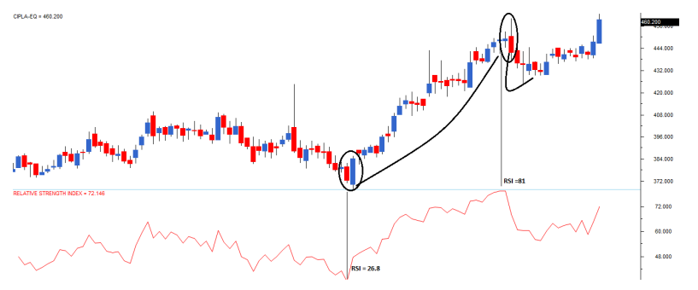

Slide 41
If the RSI is fixed in an overbought region for a prolonged period, look for buying opportunities instead of shorting
If the RSI is fixed in an oversold region for a prolonged period, look for selling opportunities rather than buying
If the RSI value starts moving away from the oversold value after a prolonged period, look for buying opportunities
If the RSI value starts moving away from the overbought value after a prolonged period, look for selling opportunities

Slide 42
MACD
Moving Averages Convergence & Divergence
Convergence & Divergence of two moving averages
MACD =( short-term MA ) - ( long-term MA )
The sign of the MACD tells us about the trend
MACD > 0 : Bullish Trend
MACD < 0 : Bearish Trend

Slide 43
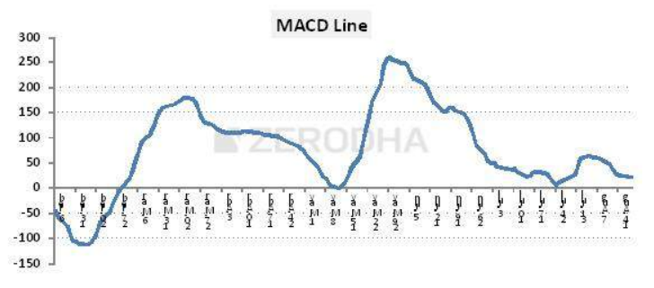
Standard MACD (12 day EMA - 26 day EMA ) for NIFTY

Slide 44
Bollinger Bands
Used to determine overbought & oversold levels
Try to sell when the price reaches the top of the band and execute a buy when the price reaches the bottom of the band
Middle line : 20 day SMA of the closing prices
Upper band : middle line + 2*SD
Lower band : middle line - 2*SD

Slide 45
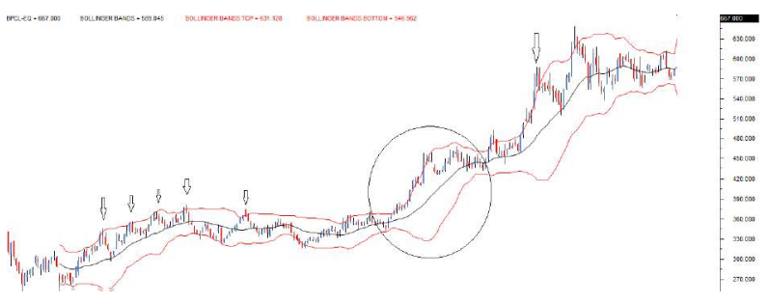
BPCL Ltd.

Slide 46
If the prices touch the upper band, they are likely to revert back to the average
If the prices touch the lower band, they are likely to rise up to the average
If the price continues to drift above the upper band (or below the lower band), the band envelope expand as well
In the case of envelope expansion, follow the trend as the
BB strategy works only in a sideways market

Slide 47
TA library indicators Documentation
Ta-Lib
Volume
Trend
Volatility
Momentum
Trend
Others

Slide 48
DAY | EVENTS | Time
DAY 1 27 / 05 / 2022 | Quant Basics | 6:00 PM to 7:00 PM
DAY 2 28 / 05 / 2022 | Technical Analysis | 4:30 PM to 6:30 PM
DAY 3 29 / 05 / 2022 | Fundamental Analysis | 4:30 PM to 6:30 PM
DAY 0 Quant Masterclass 30 / 05 / 2022 | Introduction to Projects | 6:00 PM to 7:00 PM

Slide 49
Q n A
/ Fundae session

Slide 50


Thank You

